Slide 1
Postgraduate Literacies & Research Skills Workshops
Workshop 7: Referencing techniques
Presented by :
Tapiwa Gundu (PhD)

Slide 2
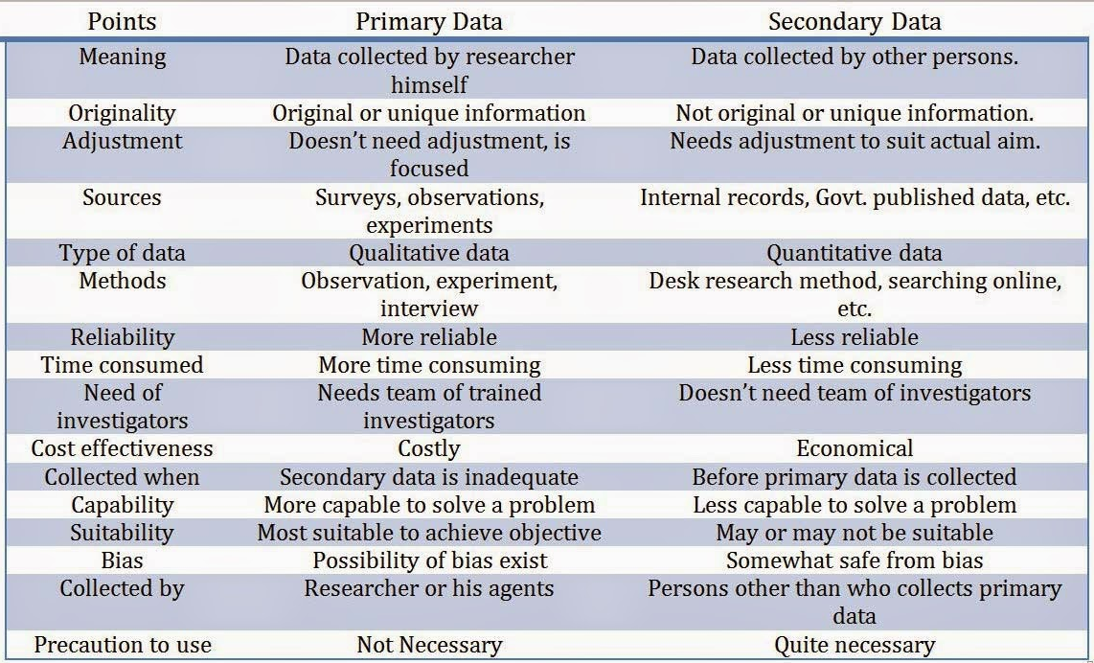
Primary data vs Secondary data

Slide 3
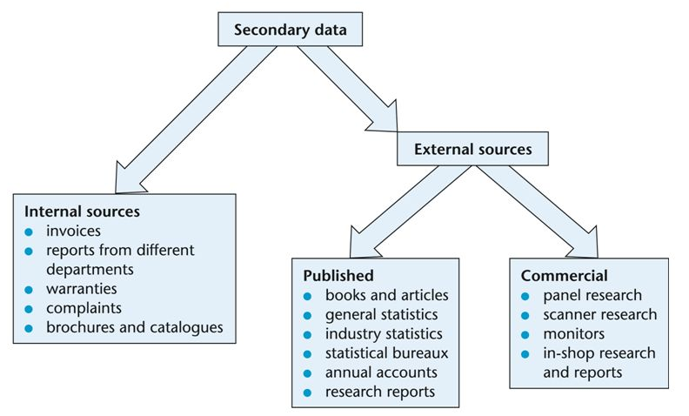
Sources of secondary data
Secondary data is the data that has already been collected through primary sources and made readily available for researchers to use for their own research. It is a type of data that has already been collected in the past.

Slide 4
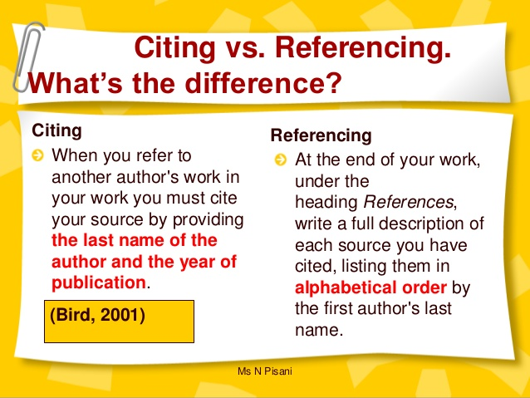
Citation and referencing

Slide 5
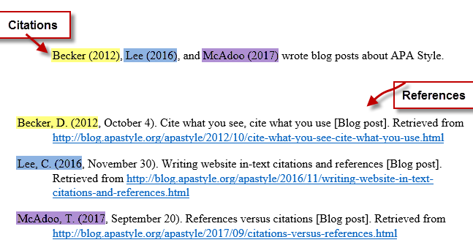
In-text referencing(citations)

Slide 6
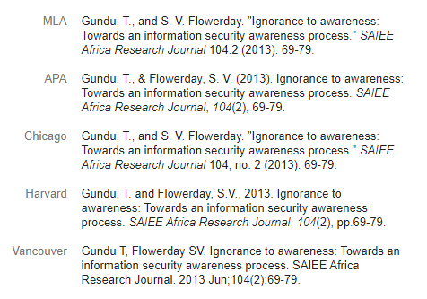
Referencing styles

Slide 7
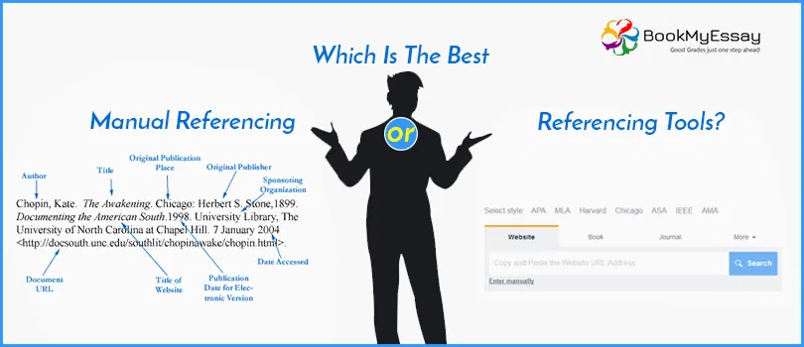
Manual referencing vs Referencing tools

Slide 8
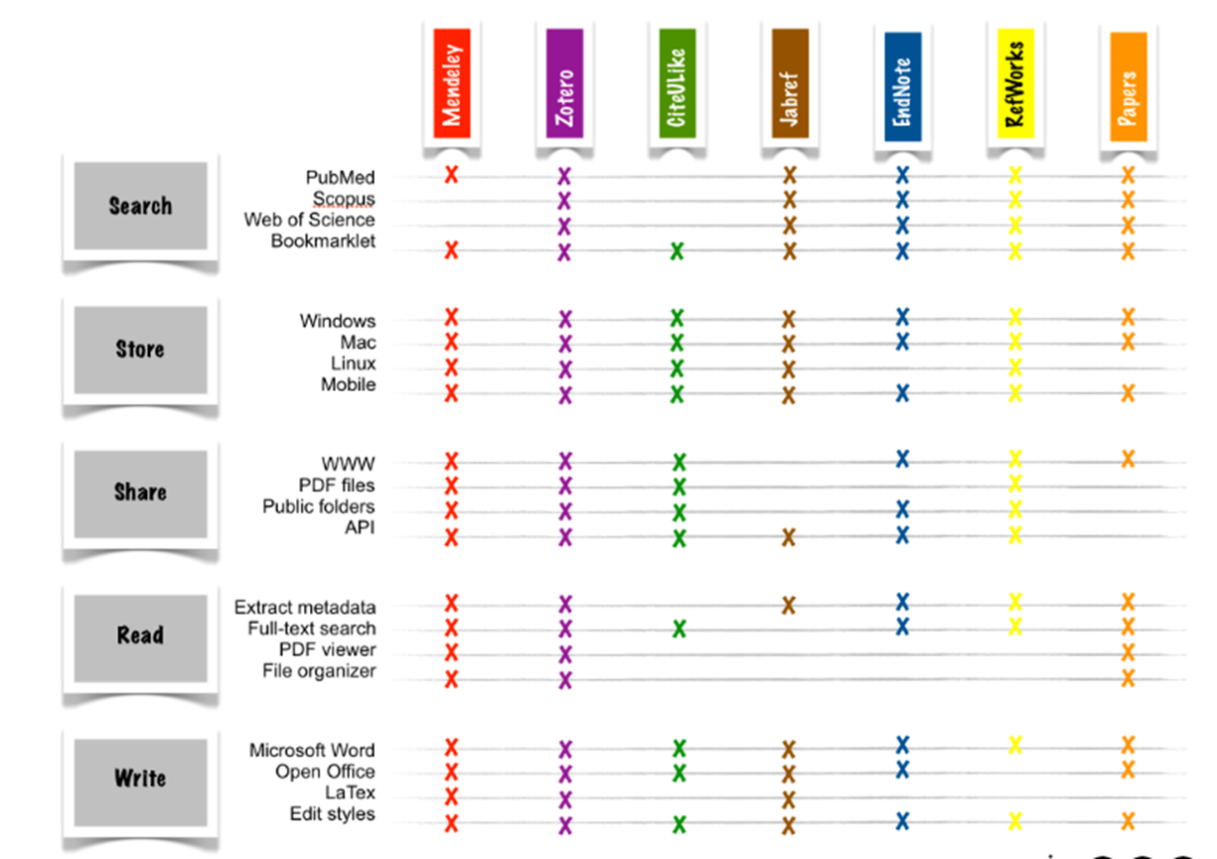
Comparison of referencing tools
https://www.youtube.com/watch?v=BQL_7C-YqBk

